Slide 1
End-to-end System for Physiotherapy Rehabilitation Monitoring
Adil Bin Azmoon
CG4001 B. Eng Dissertation 2019/2020

Slide 2
Motivations
Physiotherapy relies heavily on consistent treatment sessions
set physiotherapy schedule
encourage exercises to be continued at home
This current system hinges on the discipline of the patients in adhering to the schedule.
Highly common for patients to miss sessions.
Impossible for physiotherapists to ensure that their patients are carrying out the prescribed exercises at home.

Slide 3
Overview
The proposed system aims to integrate existing commercial hardware, such as the Microsoft Kinect, for ease of access.
The software development of the proposed system can be split into two main portions:
The machine learning algorithms and models that are required to accurately classify patients’ progress and predict their rate of recovery.
The end-to end full stack web application that will be accessed by both patients and physiotherapists.
Furthermore, the proposed system will focus on shoulder injuries and range of motion exercises for the scope of this project.

Slide 4
Literature Review
 | Sensors | Type of experiment | Targeted disease | Targeted therapy | Body parts involved
Attiya Baqai et al. (Baqai et al 2018) | Kinect for Windows Oculus Rift Arduino e-Health sensor shield v2.0 (pulse, respiration, GSR, temperature) | Intra-subject | Parkinson’s disease | Physical | Head Neck Upper limbs Lower limbs Back Step size
Zelai Saenz de Urturi Breton et al. (de Urturi Breton et al. 2012) | Kinect for Windows | Intra-subject | Dementia | Mental | Upper limbs
David Gonzalez-Ortega et al. (Gonzalez-Ortega et al. 2014) | Kinect for Windows | Intra-subject | Dementia | Mental | Upper limbs Head
Alejandro Baldominos et al. (Baldominos et al. 2015) | Oculus Rift DK2 Intel RealSense | Intra-subject | - | Physical | Shoulder abduction and adduction
Inigo de Loyola Ortiz-Vigon Uriarte et al. (Uriarte et al. 2015) | Tobii Eye Tracker Kinect for Windows Zephyr BioHarness 3 Arduino e-Health sensor shield v2.0 (EMG, GSR) | Intra-subject | - | Physical | Eyes Upper limbs

Slide 5
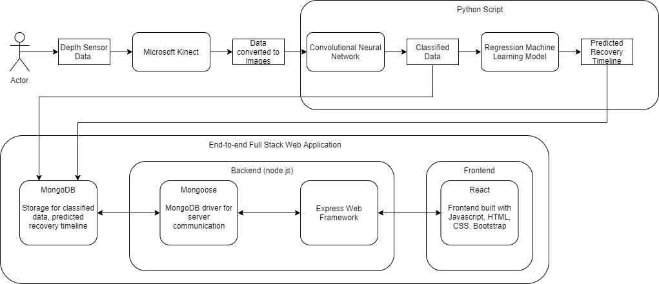
Project Overview
Monitoring system with full-stack implementation + machine learning models

Slide 6
Hardware – Kinect Sensor
Depth images are obtained using Matlab’s Image Acquisition Toolbox
Image quantity can be adjusted via Matlab script
Images are exported in PNG, ideal for use in CNN at the next stage
Ideal final implementation aims to remove Matlab as a middleware in the system

Slide 7
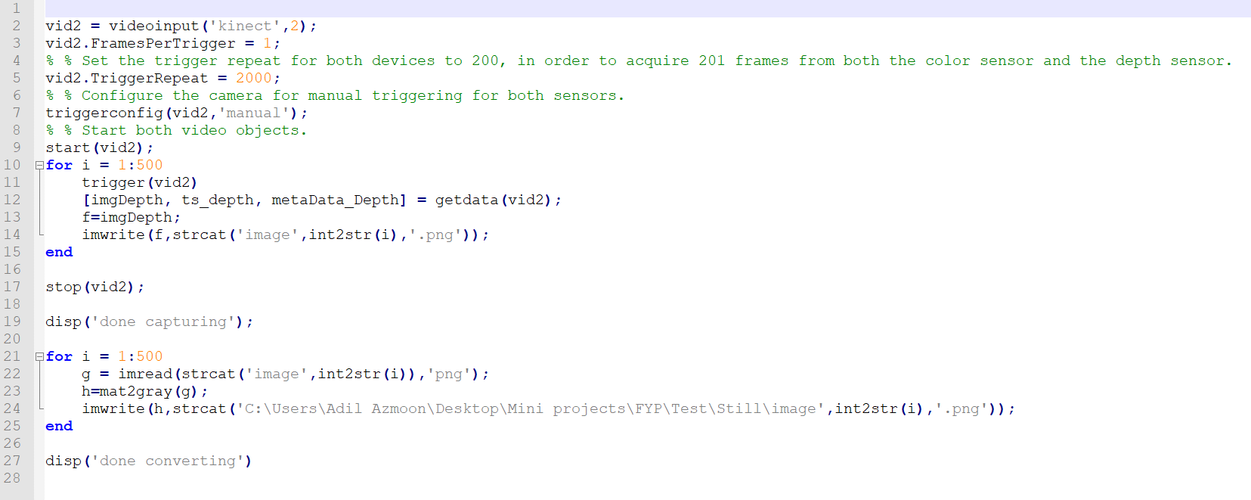
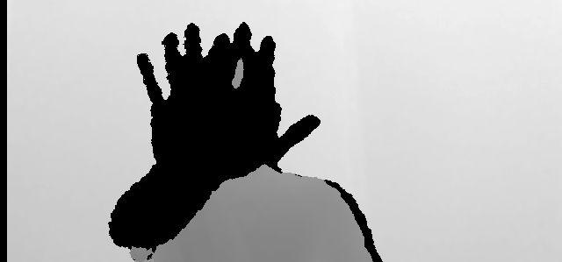
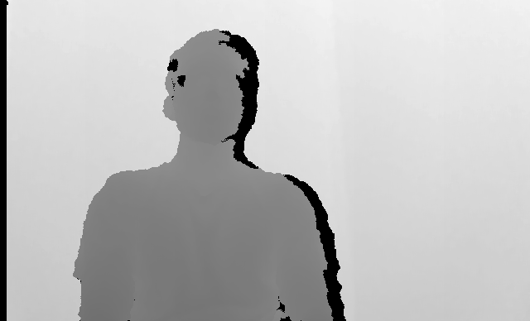
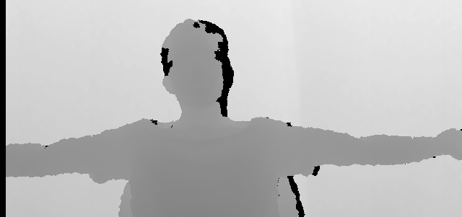
Hardware – Kinect Sensor

Slide 8
Machine Learning Models
The software will incorporate machine learning in two methods:
Convolutional Neural Network will be used in processing the patients’ current progress in rehabilitation. CNN is chosen as it is a highly popular model for image classification in machine learning.
Regression model will be used to predict/plan patients’ rate of recovery
These models will be written, trained and validated in Python utilizing existing Tensorflow and keras libraries.

Slide 9
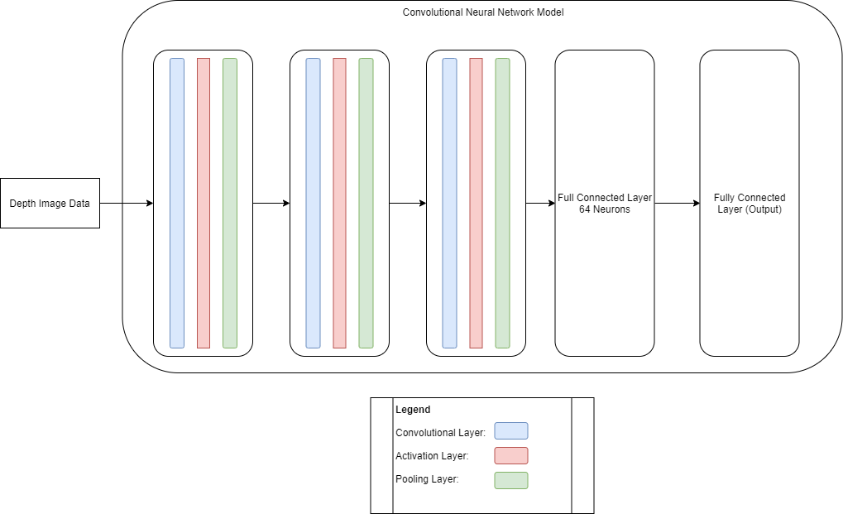
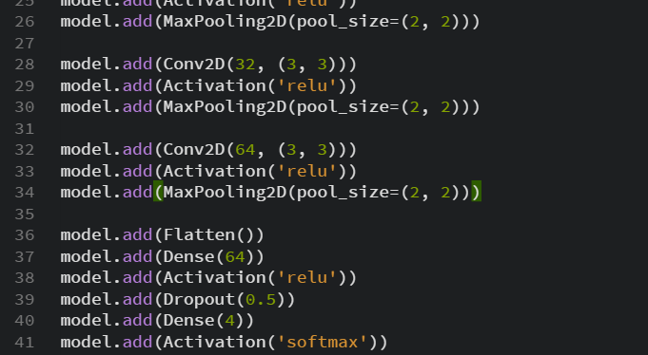
Convolutional Neural Network
Built in Python using Tensorflow library
3 convolutional layers, 3 max pooling layers 2 fully connected layers
Rectified Linear Unit activation function

Slide 10
Full Stack Web Application
Web application to be built using MERN Stack
MongoDB
Storage of patients’ progress and predicted recovery timeline
Express + node.js
Backend server
React
Frontend built with Javascript, HTML, CSS and Bootstrap

Slide 11
Conclusion
What has been done | What is next
Data acquisition technique – Microsoft Kinect | Regression Model training
Data acquisition for CNN | Regression Model testing
CNN Model training | Front-end web development
CNN Model testing | Back-end server development

